Slide 1
Decoding Stock Market
Leveraging NLP to Analyze 24+ Years of News Data For Stock Market Movement Prediction
Group - 4

Slide 2
TEAM MEMBERS
Abhindev
Sree
1.
2.
Sundar SP
Anupriya
Harpreet
3.
4.
5.

Slide 3
TABLE OF CONTENTS
1.
2.
3.
4.
PROBLEM VS SOLUTION
THE DATA COLLECTION
DATA PREPROCESSING
EDA AND INSIGHTS
Looking into Problem Statement and Solution
Data are collected using real time data using PygoogleNews and YFinance
Error deduction
Finding the missing and null values
Preparing the data for modeling by scaling features

Slide 4
TABLE OF CONTENTS
5.
6.
7.
8.
FEATURE ENGINEERING
BASE MODEL
MODEL TUNING
CONCLUSION FUTURE SCOPE
Changing raw data into format suitable for machine learning and quality of the features
Building a base model using Naive Bayes Classifier
Hyper parameter tuning using GridSearch CV
Model Deployment and Future scope

Slide 5

INTRODUCTION
Picture a system that can guess if a stock's price will go up or down tomorrow and be right about 90% of the time. That's exactly what our Stock Movement Prediction System does.
Predictive System: Capable of forecasting a stock’s price movement
Accuracy: Nearly 90% prediction accuracy
Functionality: Determines if a stock’s price close at a lower or higher rate than today

Slide 6
01
PROBLEM VS. SOLUTION
Our solution simplifies stock trading by accurately predicting tomorrow's movement through analyzing news data and stock prices, addressing the challenge of information overload faced by day traders

Slide 7
PROBLEM
SOLUTION
Day Traders’ Challenge: Overwhelmed by the vast amount of information in the stock market
Time Constraint: Lack of time to shift through resources or analyze trends
Resource Limitation: Insufficient resources for comprehensive market analysis
Core Question: Need to know if a stock’s price will rise or fall the next day
Simple algorithm analyzes today's news and stock prices to predict tomorrow's movement.
A Model that is trained on more than 24+ years of Data - Not kaggle data ;)
More Than 1.4 Lakh News Headlines from Trusted sources like (Microsoft, CNBC, Forbes….)
User-friendly Notebook on Kaggle enables day traders to quickly run code for instant stock movement insights and access Comprehensive news summaries using OpenAI, empowering informed decision-making in trading.

Slide 8
News Data and Stock Price Collection
DATA collection was not done from any repositories, Each and every data was collected and framed into files using PyGoogleNews and Yfinance

Slide 9
DATA SCRAPING
Stock News
Stock Price
Collected news data using Pygoogle news from Google News
Created data frames to store results from 2000 to 2024
Collected stock price data using Yfinance.
Created CSV file ‘MSFT_STOCK.csv’ from 2000 to 2024
.

Slide 10
Sentiment Extraction
Distil Roberta
Text Blob
Vader Sentiment Analysis
VADER (Valence Aware Dictionary and sEntiment Reasoner) is a lexicon and rule-based sentiment analysis tool that is specifically designed for analyzing sentiments expressed in text.
This model is a fine-tuned version of LLM distilroberta-base from Hugging Face on the financial_phrasebank dataset.
TextBlob is a Python library used for Natural Language Processing (NLP)

Slide 11
Stock Data After Adding Sentiment
SUBJECTIVITY | POLARITY | COMPOUND | POS/NEG/NEU
Describe | Describe | Describe | Describe
Num | Num | Num | Num

Slide 12
Data Cleaning
Error Detection: Identify and flag errors like missing values, duplicates, and outliers within the dataset.
Error Correction: Apply techniques like imputation for missing data, deduplication for duplicates, and outlier removal for anomalies.
Standardization: Ensure consistency by standardizing formats and values across the dataset, enhancing its usability and reliability for analysis.

Slide 13
News Data After Cleaning
TITLE | DATE | WEB | AUTHOR
News Headline | Date and time, News is collected | Website from which News is collected | Author of the News
Text | Datetime | Text | Text

Slide 14
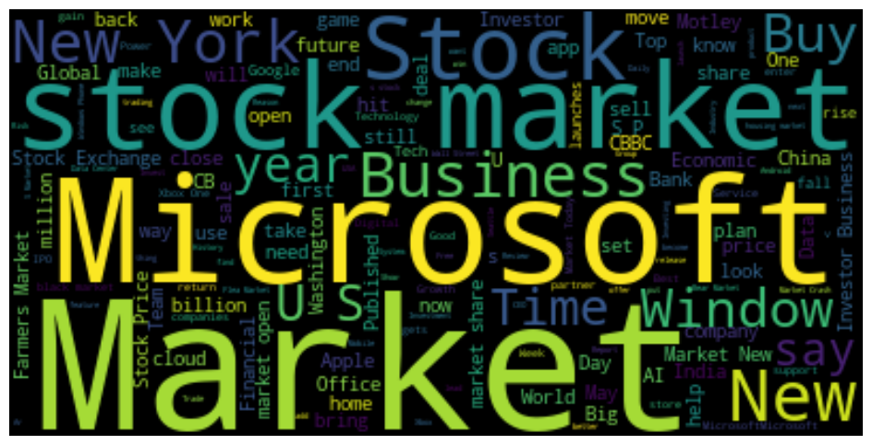
WORD CLOUD OF 1.4L HEADLINES

Slide 15
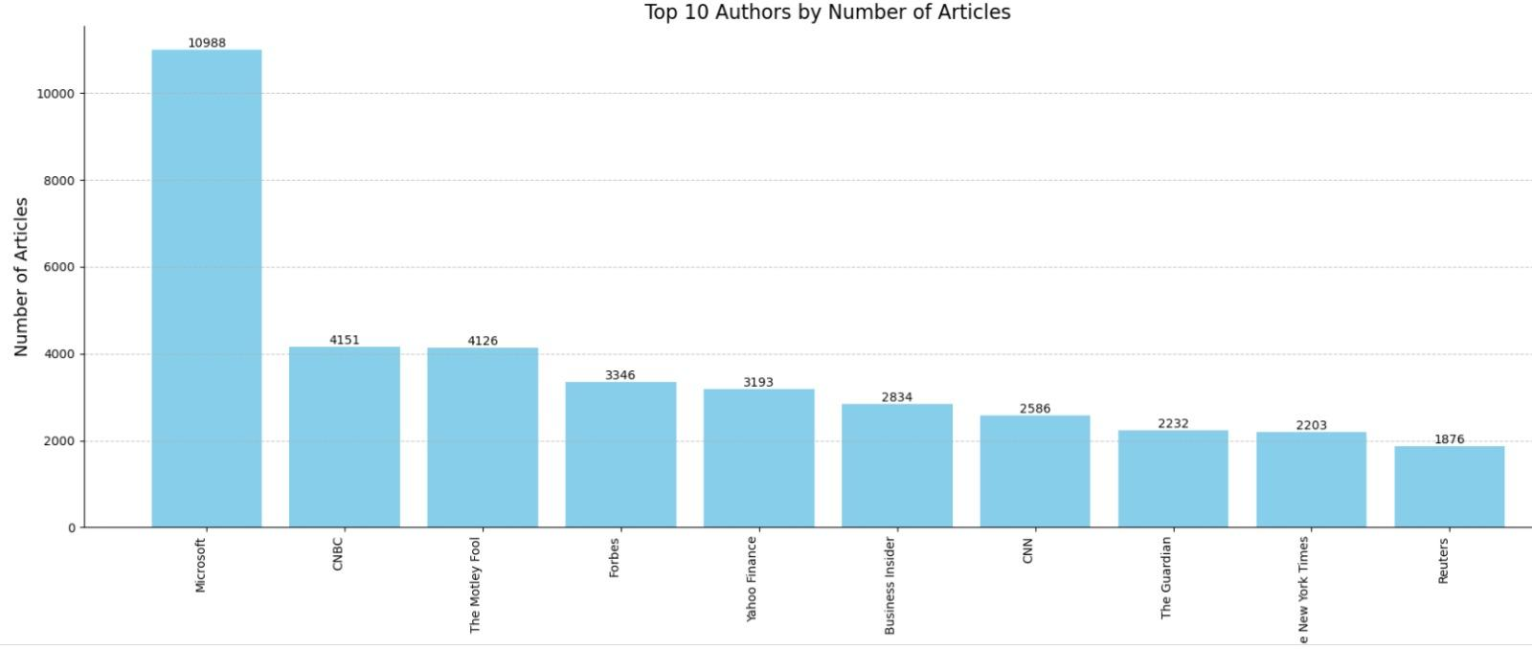
Top 10 Author buy No of Articles

Slide 16
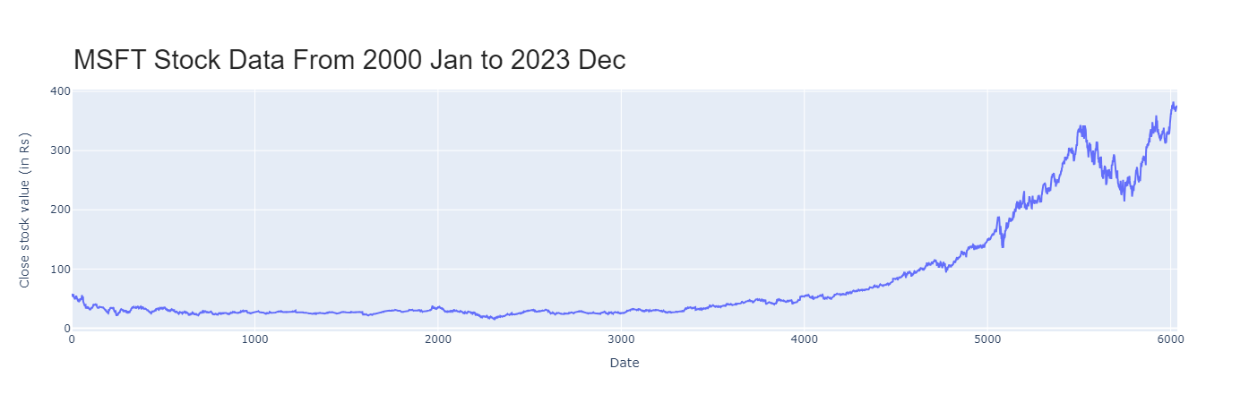
MSFT STOCK CLOSE PRICE

Slide 17
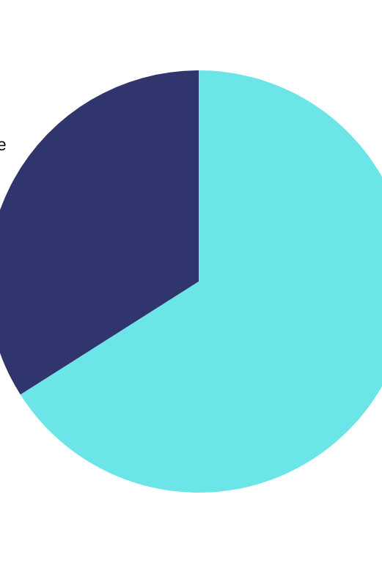
PERCENTAGE OF SENTIMENT
66%
34%
Positive Sentiment
Negative Sentiment
Vader Sentiment Analyzer is used on our data to get the News Sentiment on each Day
24+
Years

Slide 18
FEATURE TRANSFORMATION
MOVING AVG
Exponential Moving Average
Bollinger Bands
Logarithmic Momentum
To capture short-term and longer-term trends in the data. 7D and 12D
Difference between the 26-day exponential moving average (EMA) and the 12-day EMA of the 'Close' price.
Calculates the 20-day STD deviation of the 'Close' price after computing upper and lower Bollinger Bands by adding/ subtracting two times the SD from the 20-day moving average.
Taking the natural logarithm of the difference between the 'Close' price and 1.

Slide 19
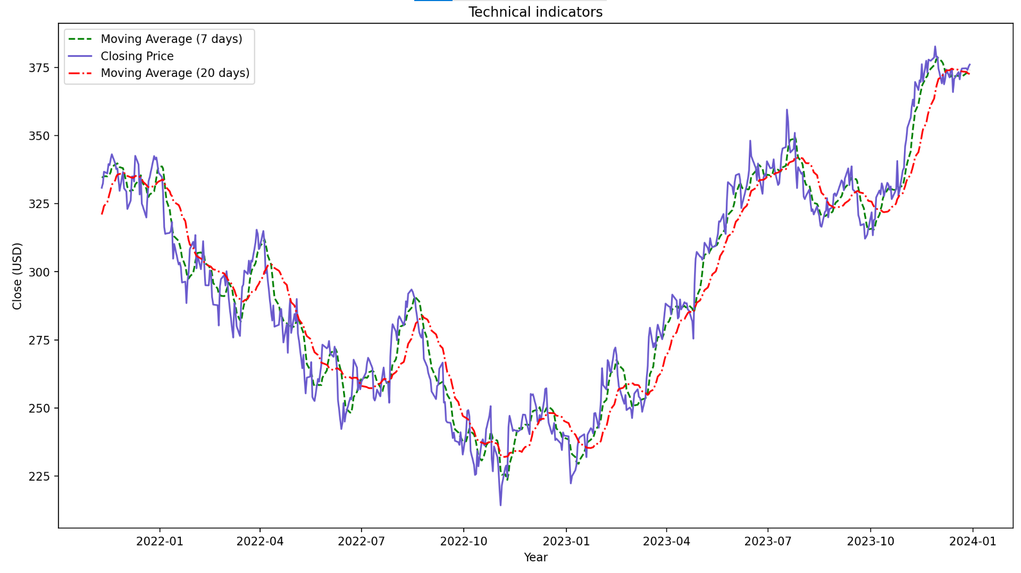
CLOSE PRICE WITH STOCK INDICATORS

Slide 20
BASE MODEL
Model Instantiation
Creates an instance of the Gaussian Naive Bayes classifier object.
Sentiment analysis on stock market data using Gaussian Naive Bayes classifier
2. Model Training
The classifier is trained and the classifier learns the parameters necessary to make predictions based on the input features.
3. Prediction
Predictions are made on taking the input features and returns the predicted class labels
Target Variable: Movement
Notes:
train_data_start = '2005-01-03'
train_data_end = '2021-12-31'
test_data_start = '2022-01-01'
test_data_end = '2023-12-31'
Accuracy, confusion matrix, classification report

Slide 21
Inference from Base Model
Testing Data
Training Data
Accuracy: 50.70% - Classifier correctly predicted the movement (up or down) of the stock prices approximately 50.70% of the time on the testing data.
2
4
Accuracy: 51.65% - Classifier correctly predicted the movement (up or down) of the stock prices approximately 51.65% of the time on the training data.
Precision: 0.53- Average proportion of true positive predictions
Observed that, the classifier's performance is Poor
1
3

Slide 22
COMPARATIVE ANALYSIS of DIFFERENT MODELs
LOGISTIC REGRESSION
GRADIENT BOOSTING
RANDOM
FOREST
SUPPORT VECTOR MACHINE
K-NEAREST NEIGHBORS
MULTI-LAYER PERCEPTRON

Slide 23
MODEL METRICS
MODEL NAME |  |  |  |  | Training Accuracy | Test Accuracy
Logistic Regression |  |  |  |  | 87 | 88
Random Forest |  |  |  |  | 100 | 52
K-Nearest Neighbour |  |  |  |  | 76 | 54
Gradient Boosting |  |  |  |  | 78 | 53
Multi Layer Perceptron |  |  |  |  | 65 | 64

Slide 24
FINAL MODEL PARAMETER
C = 120
Penalty = L2
LOGISTIC REGRESSION TEST SCORE
Pression
Recall
F1-Score
Regularization strength in logistic regression
L2 (Ridge)
92%
82%
89%

Slide 25
FINAL MODEL TEST METRICS
PRECISION
RECALL
F1-SCORE
1
92%
86%
89%
ACCURACY
89%
PRECISION
RECALL
F1-SCORE
0
86%
92%
89%
Logistic Regression
Notes:
Logistic regression has better accuracy - so fine tuning it with grid search CV
# Define the parameter grid
param_grid = {
'C': [100,110,120,130], # Regularization parameter
'penalty': ['l1', 'l2'] # Penalty term ('l1' for Lasso, 'l2' for Ridge)
}

Slide 26
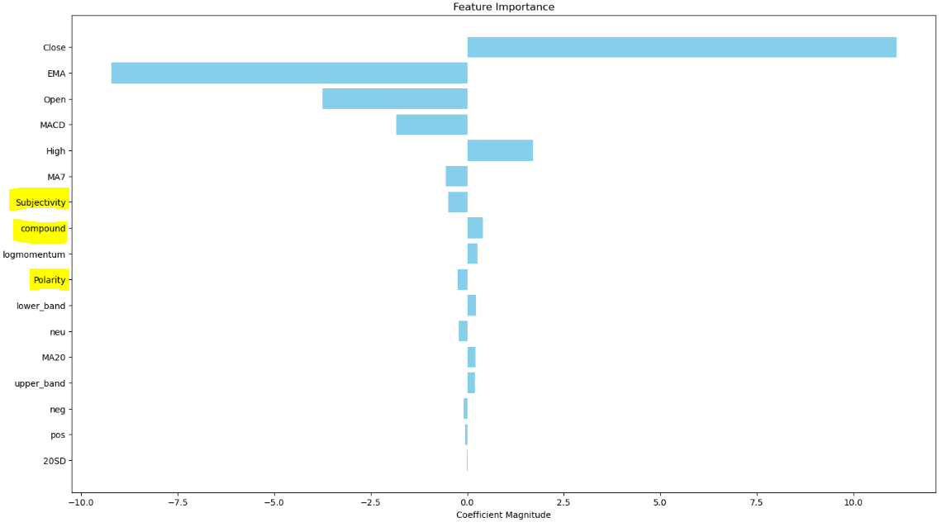
Notes:
Plot of % of impact made by each datapoints on the target variable variable (movement)

Slide 27

INTERACTIVE KAGGLE NOTEBOOK
The user-friendly Notebook on Kaggle allows day traders to efficiently execute code for instant insights into stock movements and access comprehensive news summaries using OpenAI. This empowers traders to make informed decisions in their trading activities.

Slide 28
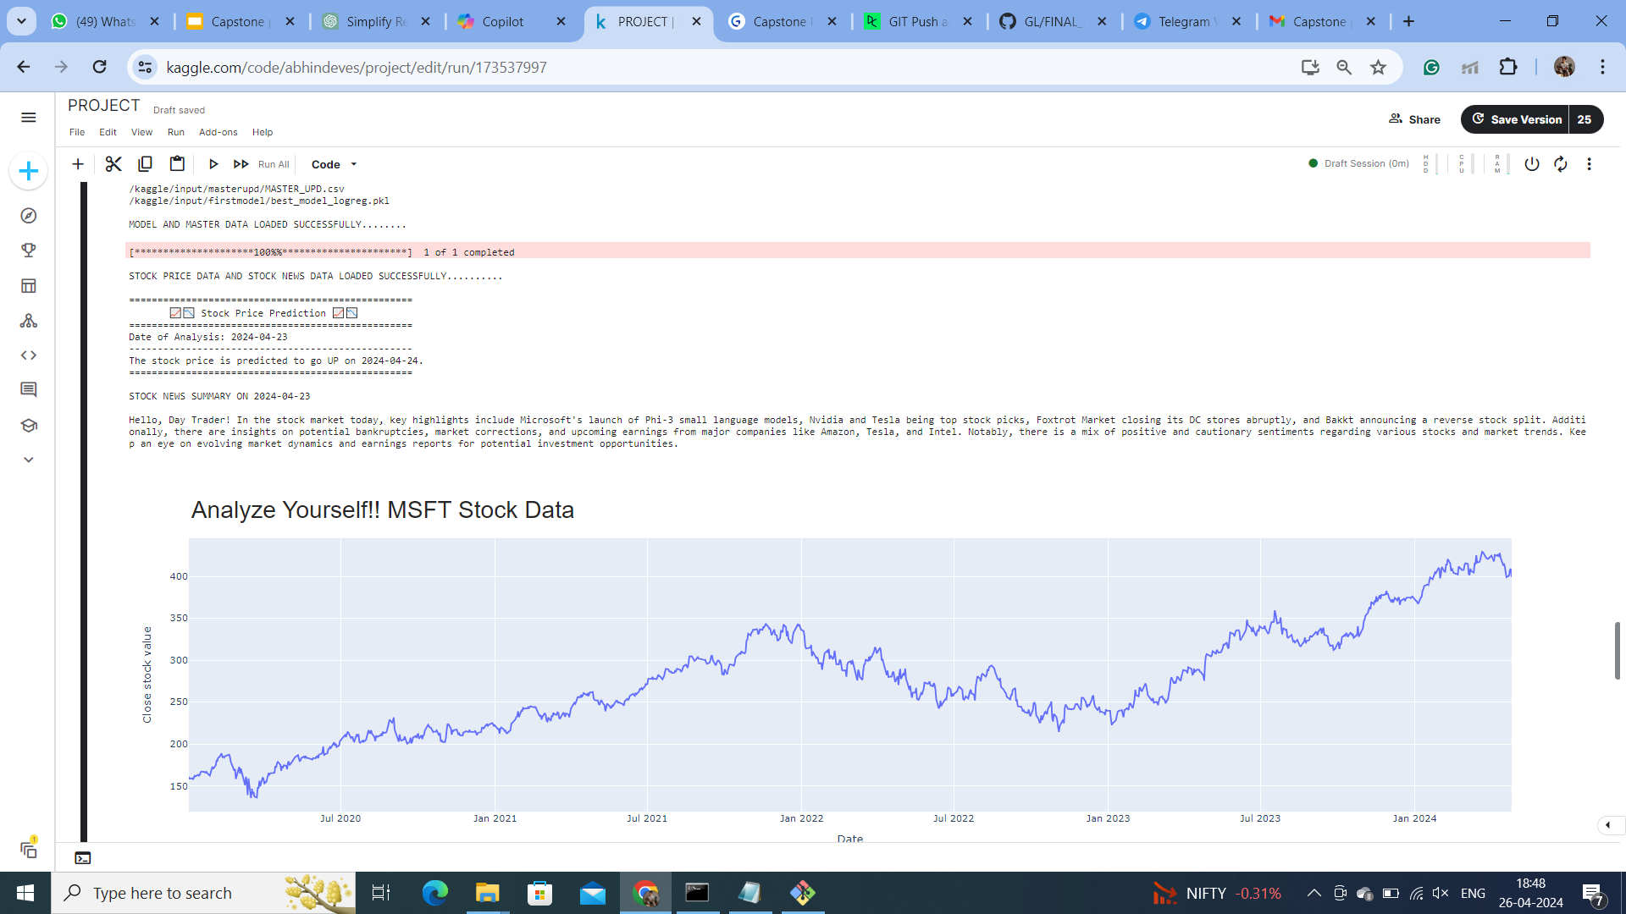

Slide 29
NOTEBOOK FEATURES
MOVEMENT
AI Summary
Predict whether the Stock will Close Higher or Lower Tomorrow
Get Summary of Today's news regarding the stock from GPT 3.5 Turbo
TREND CHART
METRICS
GIves an Interactive Plot on the Stock Closing Price
Provides the Training and Testing Metrics of the Model

Slide 30
CAPABILITIES AND LIMITATIONS
LIMITATIONS
CAPABILITIES
NOT ALWAYS RIGHT
ASYNC
TOOL
ACTIONABLE
It may not perform accurately under unusual market conditions or limited data, and cannot replace human judgment in trading decisions.
Model cannot predict sudden market events or changes in sentiment.
Valuable decision-making tool.
Our System empowers traders with actionable insights.

Slide 31
FUTURE SCOPE
1
2
3
4
SCHEDULED NOTEBOOK
REAL TIME ACCURACY
CUSTOM TICKER
LLMs FOR SENTIMENT
Notebook Runs Daily and Displays Result on a Scheduled Time
Calculate and display the real time accuracy of the model after one prediction
Enable User to Select the Stock and Predict the movement for that Stock
Use Models from HuggingFace or Langchain for more accurate Sentiment Analysis

Slide 32
THANKS!

